Slide 1
SiMLeng PROJECT PIMA INDIAS DATASET CLASSIFICATION TRAINING
RUPERTO P. BONET
rpbonetch@gmail.com

Slide 2
PIMA INDIAS DATASET
This study is about Pima Indians, a community of American Indians in Arizona, which have an unusual high incidence and prevalence of diabetes mellitus.

Slide 3

ABOUT THE DIABETES MELLITUS
From Wikipedia, the free encyclopedia Diabetes mellitus type 2 (also known as type 2 diabetes) is a long-term metabolic disorder that is characterized by high blood sugar, insulin resistance, and relative lack of insulin, increased thirst, frequent urination, and unexplained weight loss. Symptoms may also include increased hunger, feeling tired,

Slide 4
ABOUT THE DIABETES MELLITUS
Type 2 diabetes primarily occurs as a result of obesity and lack of exercise. Type 1 diabetes occurs due a lower total level of insulin to control blood glucose, due to an autoimmune induced loss of insulin-producing beta cells in the pancreas. Diagnosis of diabetes is by blood tests such as fasting plasma glucose, oral glucose tolerance test, or glycated hemoglobin (A1C).

Slide 5
ABOUT THE DIABETES MELLITUS
PREVENTION
Type 2 diabetes is partly preventable by staying a normal weight, exercising regularly, and eating properly.
RATES Rates of type 2 diabetes have increased markedly since 1960 in parallel with obesity.
YEAR DIAGNOSED WITH DESEASE(Mills)
1985 30
2015 392(around 90% of cases)
Type 2 diabetes is associated with a ten-year-shorter life expectancy

Slide 6
ABOUT THE DIABETES MELLITUS
WHO DIABETES DIAGNOSTIC CRITERIA
CONDITION | 2-hour glucose | Fasting glucose
Unit | mmol(mg/dl) | mmol/l(mg/dl)
Normal | <7.8 (<140) | <6.1 (<110)
Impaired fasting glucosa (IFG) prediabetes | <7.8 (<140) | ≥6.1(≥110) & <7.0(<126)
Impaired glucosa Tolerance(IGT) Prediabetes | ≥7.8 (≥140) | <7.0 (<126)
Diabetes mellitus | ≥11.1 (≥200) | ≥7.0 (≥126)

Slide 7

OUTLINE
INTRODUCTION
VARIABLES AND ITS CLASSIFICATION
DATA EXPLORATION
FEATURES SELECTION(p-values,Z-score,PCA)
VALIDATION (Full data, partial data)
K-Fold Cross-validation
PREDICTION
COMPARISON WITH OTHER METHODS
PRELIMINARY CONCLUSIONS
COMPUTATIONAL TOOLS

Slide 8
INTRODUCTION
This project investigates the computational tools that allow predict the presence or not
of Diabetes mellitus based on the Dataset Pima Indias from UCI Machine Learning
Repository. Two versions are examined when this project is finished.
Along this preliminary study only will be shown the statistics related to the small dataset,
In which, the training and test data have a size of 200x8 and 332x8, respectively.
All numerical results have been obtained using statsmodels package, which has been the
core of simleng v0.0 code , developed by the author.
The computation has been developed in a PC model HP with the following
Description:
CPU product: AMD E2-9000e RADEON R2, 4 COMPUTE CORES 2C+2G
vendor: Advanced Micro Devices [AMD]
physical id: 4
version: AMD E2-9000e RADEON R2, 4 COMPUTE CORES 2C+2G
slot: Socket FP4
size: 1201MHz
capacity: 1500MHz
width: 64 bits
clock: 100MHz
MEMORY: 4 GB
.

Slide 9
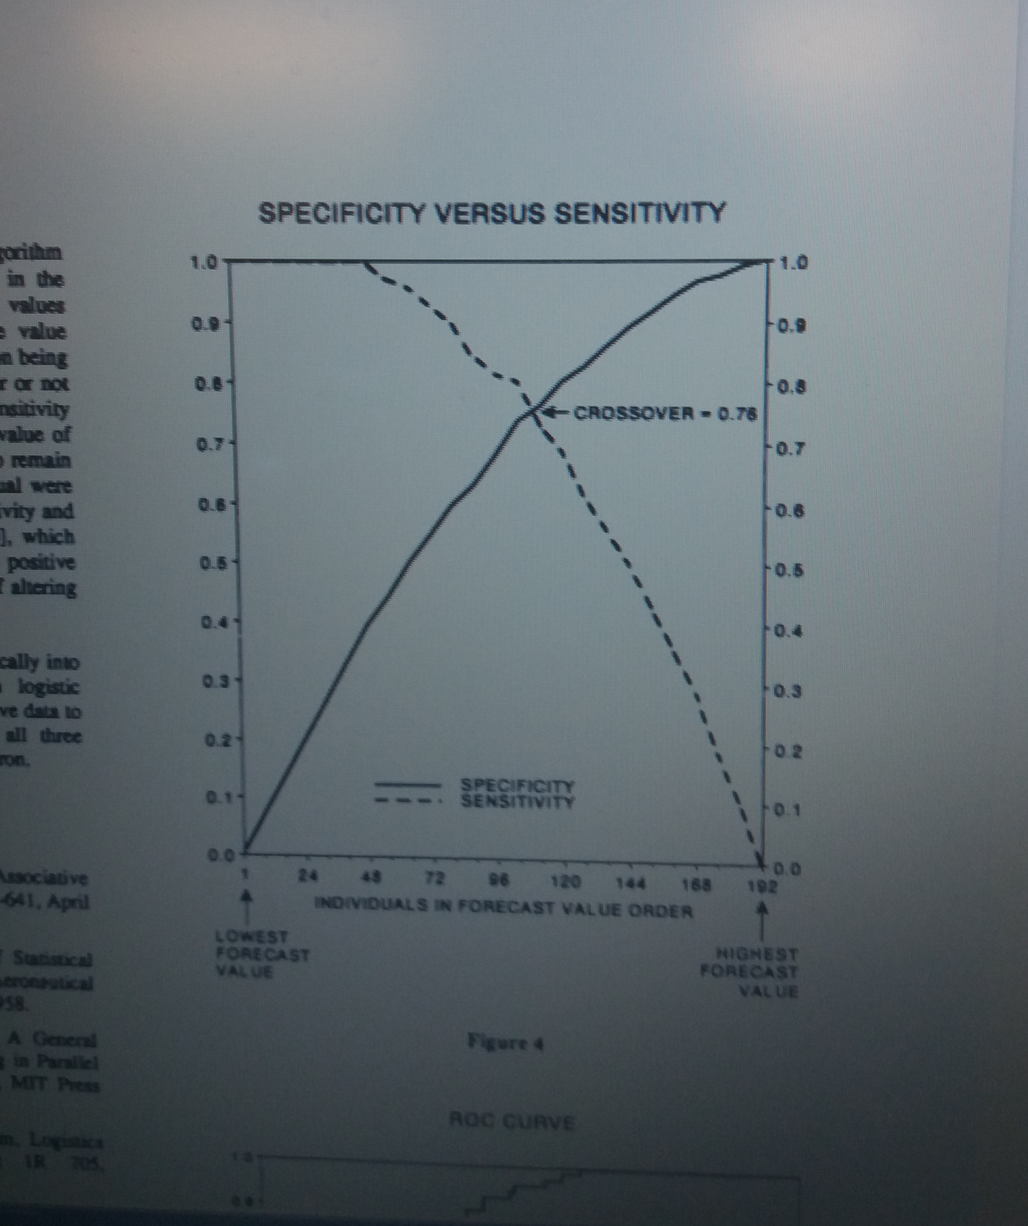
PREVIOUS WORKS
Louis T. Montour, MD, CM, CCFP.Medical director,Ann C. Macaulay, MD, CCFP.Kateri. Memorial Hospital Centre,Kahnawake, PQ,1985. High prevalence rates of diabetes Mellitus and hypertension on a North AmericanIndian reservation. Cannadian Medical Association Journal, Vol 132 May 15 .
National Diabetes Data Group, 1979: Classification and diagnosis of diabetes mellitus and other categories of glucose intolerance. Diabetes, Vol 28: 1039-1057
Jack W. Smith et al., 1988. Using the ADAP Learning Algorithm to Forecast the Onset of Diabetes Mellitus. 0195-4210/88/0000/0261$01.00 C SCAMC, Inc.

Slide 10
MEASURED VARIABLES
The data set has 8 variables, and the typical machine learning task is to predict the class variable of whether
the subject has been diagnostic diabetes or not.
_____________________________________________
Number of times pregnant [npreg] Plasma glucose concentration [glu] Diastolic blood pressure (mm Hg) [bp] Triceps skin fold thickness (mm) [skin] Body mass index (weight in kg/(height² in m² ) [bmi] Diabetes pedigree function[ped] Age (years)[age] Diabetes (No or Yes) [Type] ____________________________________________

Slide 11
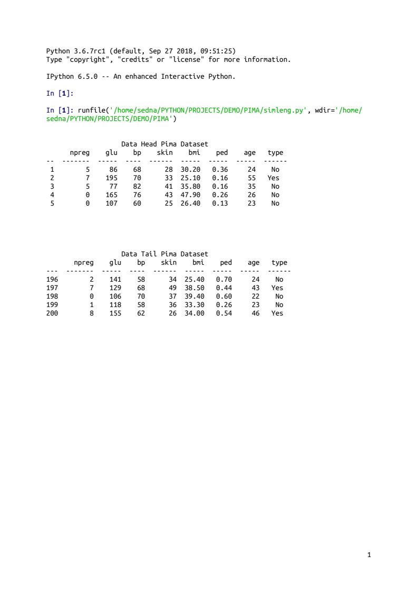
DATA EXPLORATION

Slide 12
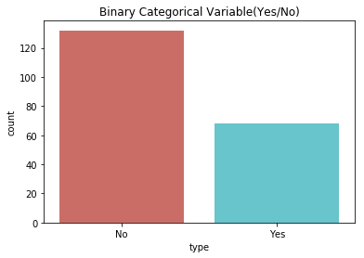
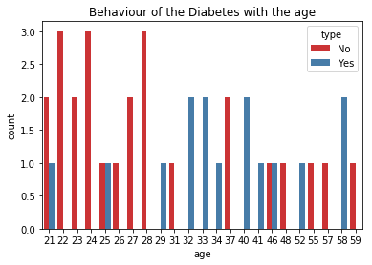
DATA EXPLORATION

Slide 13
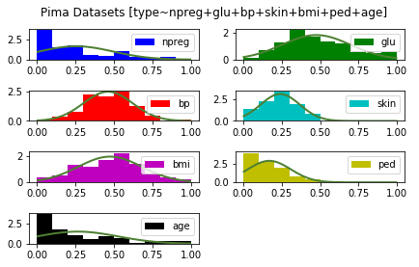
Predictors Histogram-Normal pdf

Slide 14
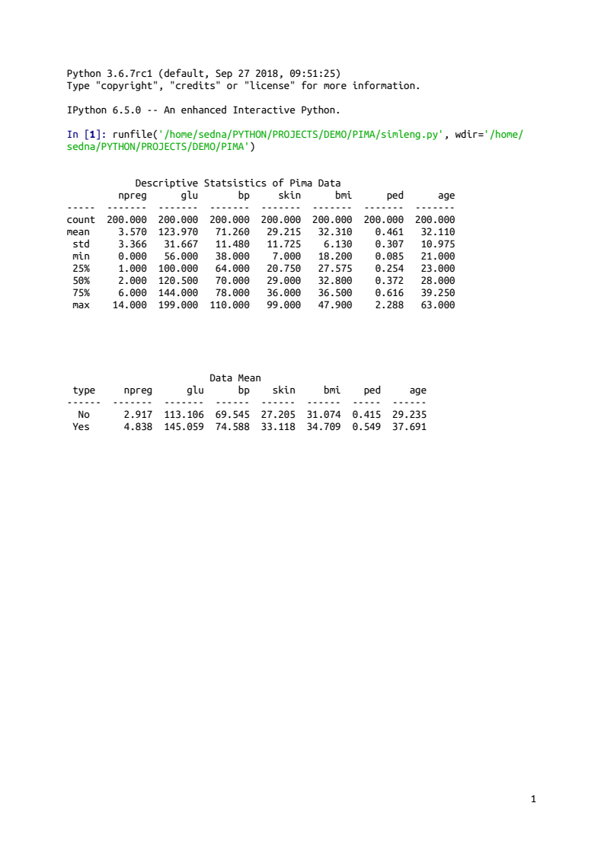
DATA EXPLORATION

Slide 15
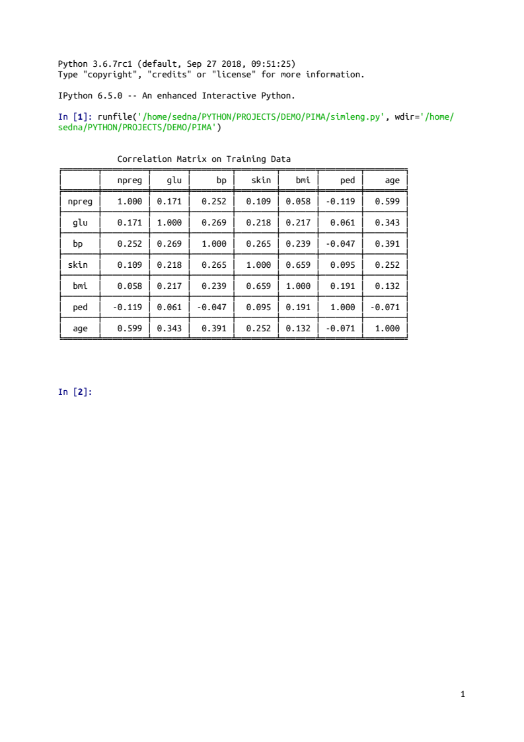
DATA EXPLORATION

Slide 16
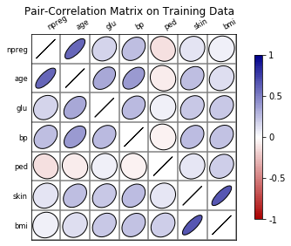
DATA EXPLORATION
Treshold Value:0.90
The predictors are slightly correlationed

Slide 17
DATA EXPLORATION
VARIANCE INFLUENCE FACTORS
Predictor | VIF Factor
bmi | 11.280
skin | 8.615
bp | 8.250
glu | 6.089
age | 3.691
npreg | 3.258
ped | 2.489
bmi and skin predictors are collinears

Slide 18
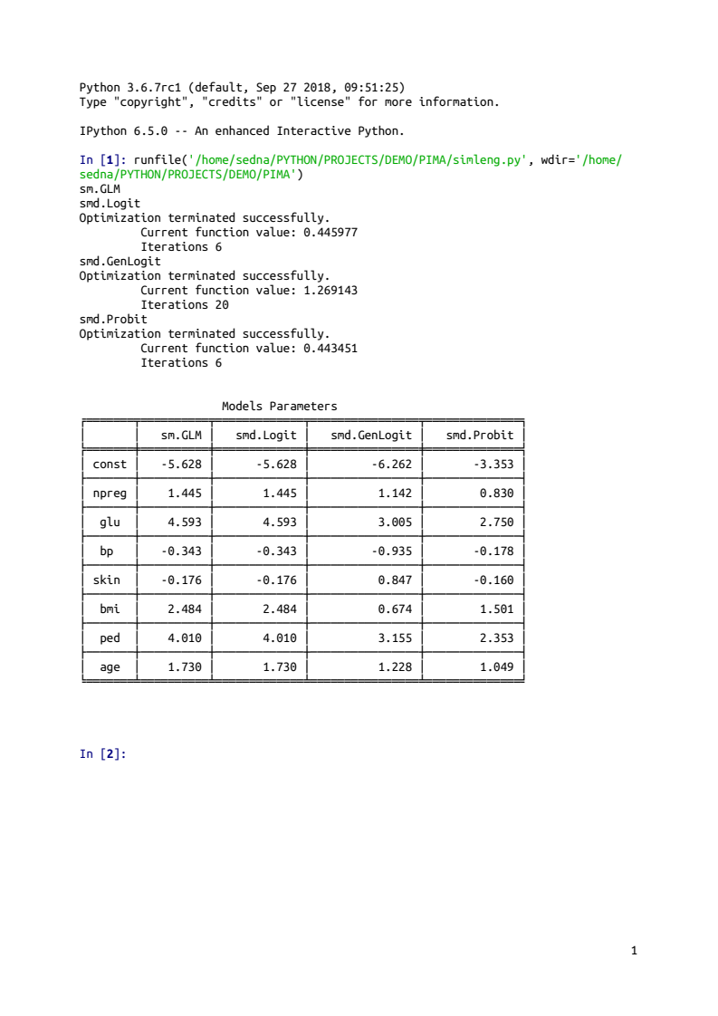
FITTING WITH FULL DATA

Slide 19
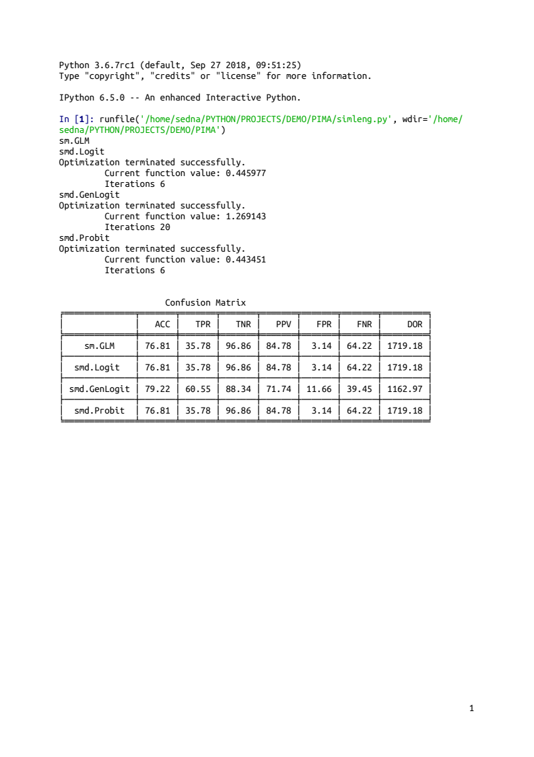
CONFUSION MATRIX

Slide 20
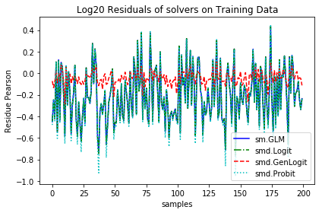
NUMERICAL RESULTS

Slide 21
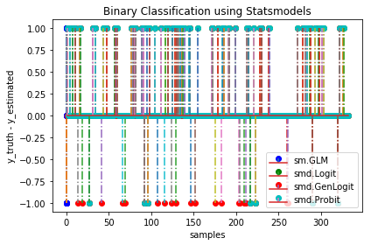
BINARY CLASSIFICATION RESULTS

Slide 22
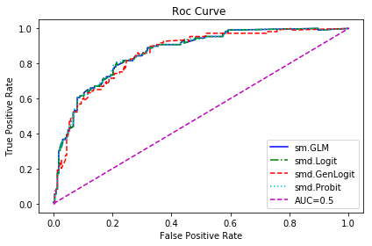
BINARY CLASSIFICATION RESULTS

Slide 23
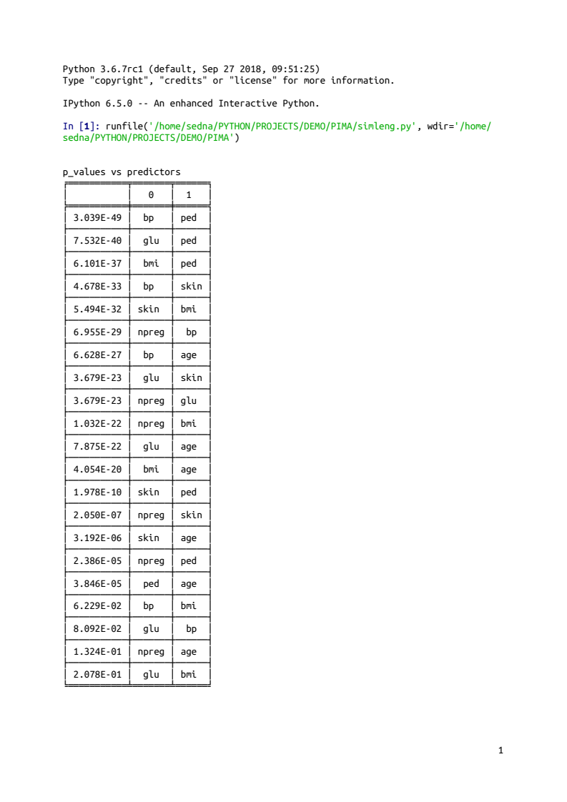
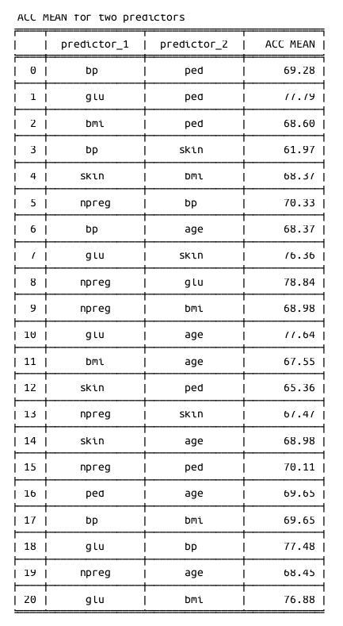
FEATURES SELECTION P-VALUES
Good selection
Best selection

Slide 24
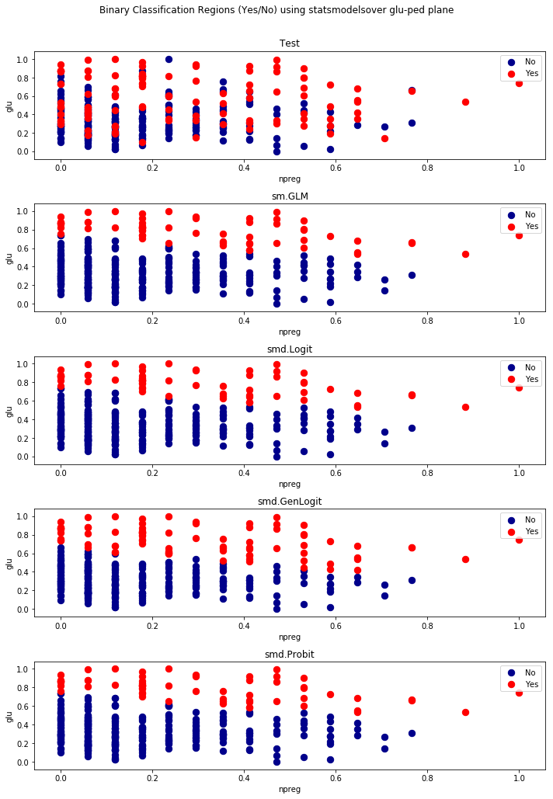
FEATURES SELECTION P-VALUES

Slide 25
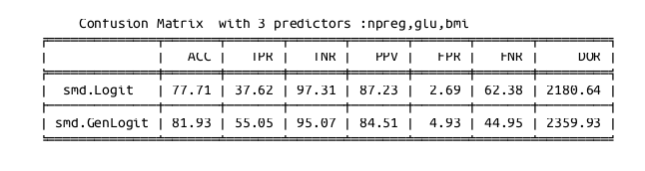
BEST FEATURES SUBSET
The Best performance is 81.93% using smd.GenLogit (C=0.2) with 3 predictors
npreg,glu,bmi
smd.Logit smd.GenLogit
Optimization terminated successfully.
Current function value: 0.474714 1.285654
Iterations 6 17

Slide 26
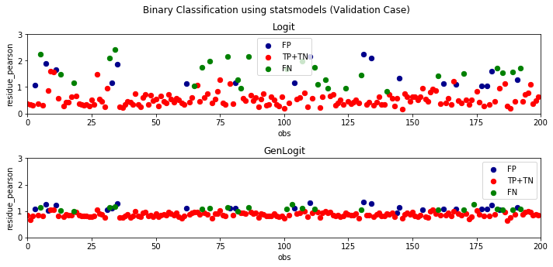
BEST FEATURES SUBSET
The Best performance is 81.93% using smd.GenLogit (C=0.2) with 3 predictors
npreg,glu,bmi

Slide 27
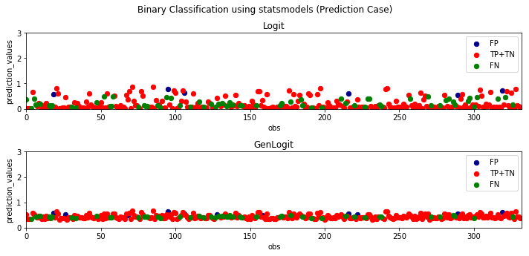
BEST FEATURES SUBSET
The Best performance is 81.93% using smd.GenLogit (C=0.2) with 3 predictors
npreg,glu,bmi

Slide 28
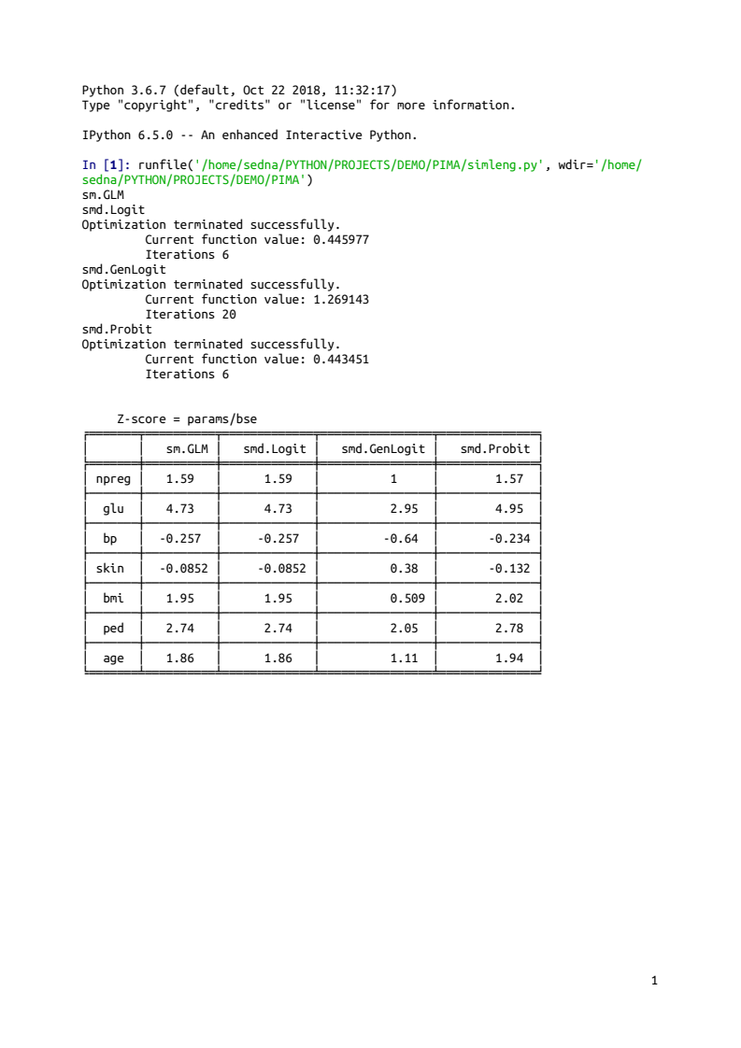
FEATURES SELECTION Z-SCORE
========================================================
There are predictors strongly significative to level 0.025 :
glu,ped
========================================================

Slide 29
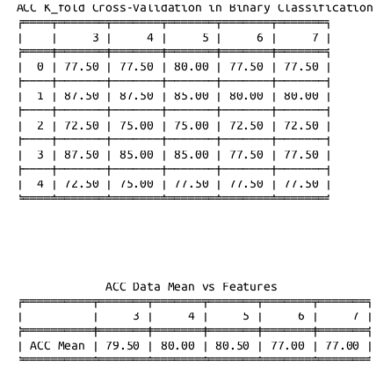
CROSS VALIDATION K_FOLD=5 (IMPLEMENTATION IN STATSMODELS)

Slide 30
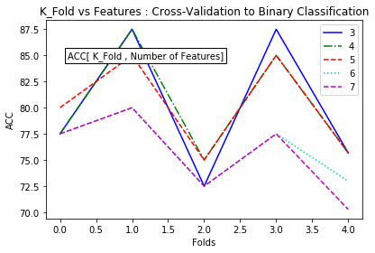
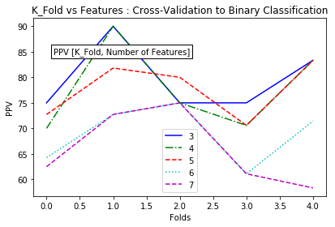
CROSS VALIDATION K_FOLD=5

Slide 31
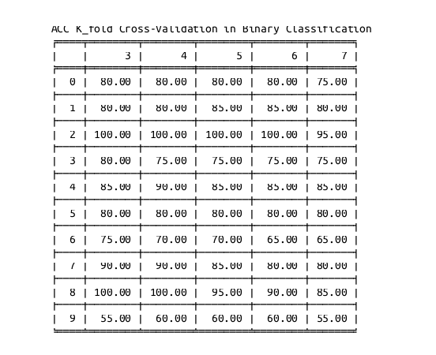
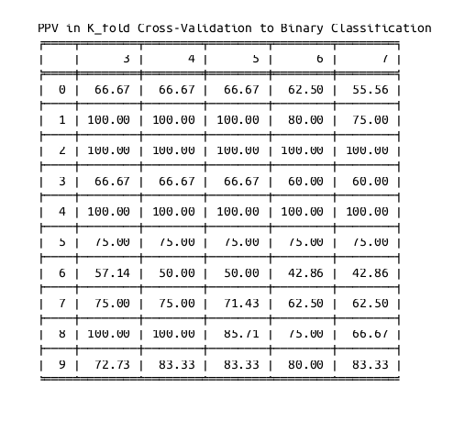
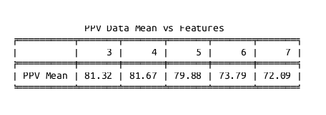
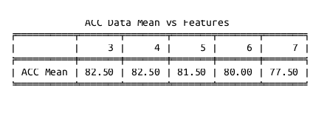
CROSS VALIDATION K_FOLD=10

Slide 32
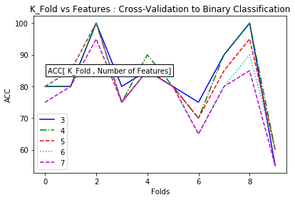
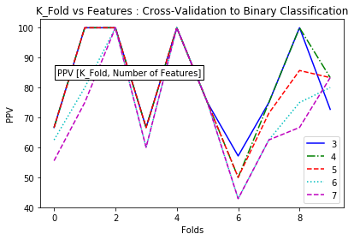
CROSS VALIDATION K_FOLD=10

Slide 33
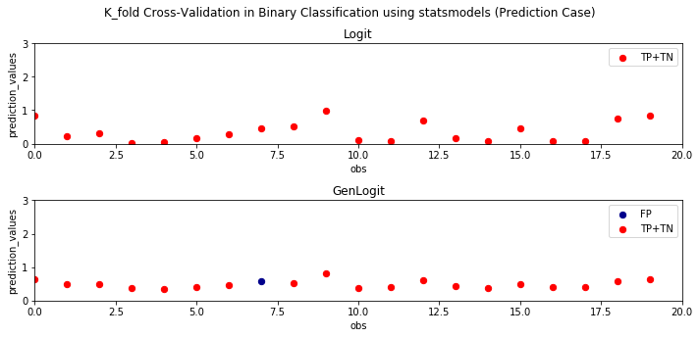
CROSS VALIDATION K_FOLD=10
Splitting the dataset in 10 folds and testing the folder number:2 ,
The Best performance is 100.00% using smd.Logit with 6 predictors
Predictors : glu,ped,bmi,skin,bp,npreg

Slide 34
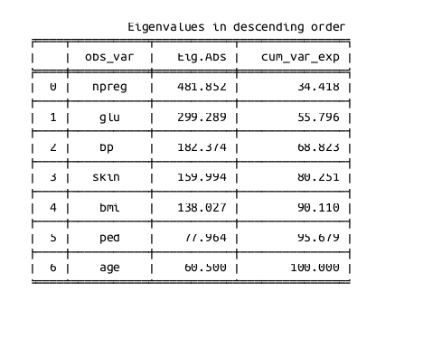
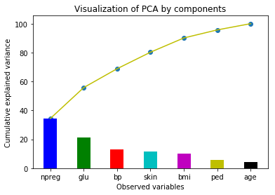
FEATURES SELECTION
PCA(ncomp=7)

Slide 35
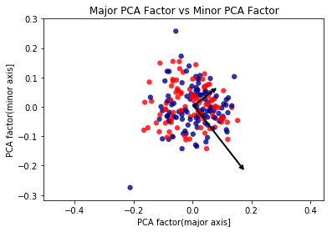
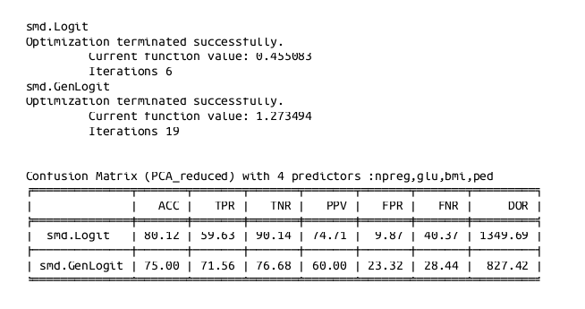
FEATURES SELECTION
PCA(ncomp=4)

Slide 36
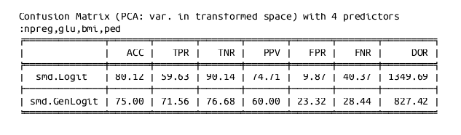
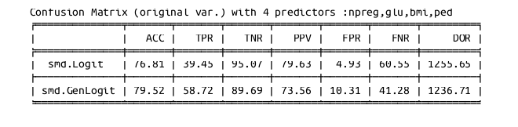
FEATURES SELECTION
PCA(ncomp=4)

Slide 37
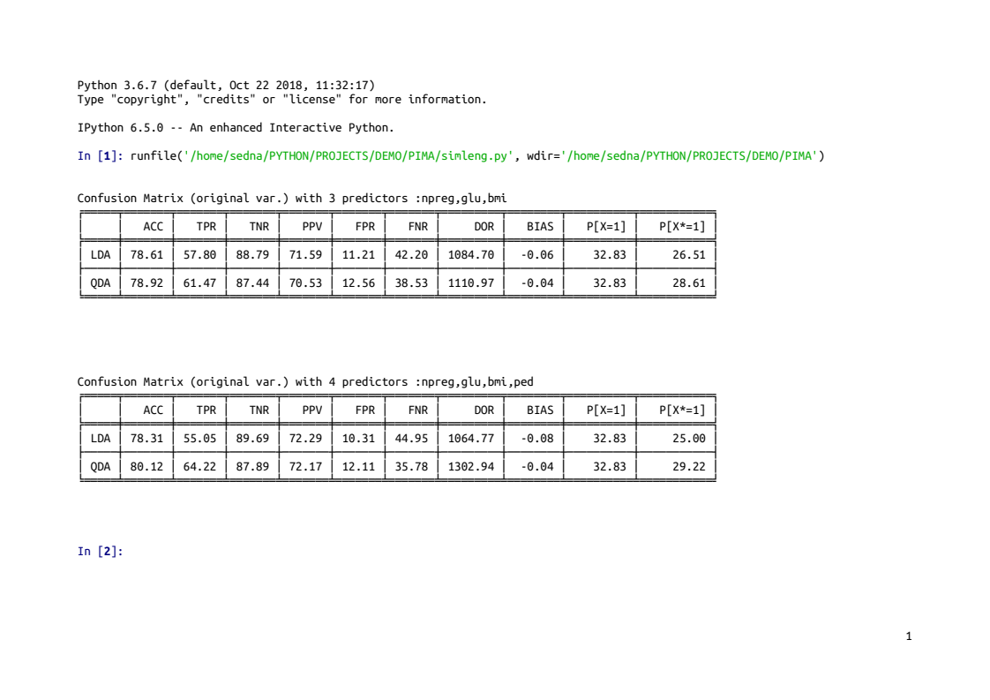
DISCRIMINATIVE METHODS

Slide 38
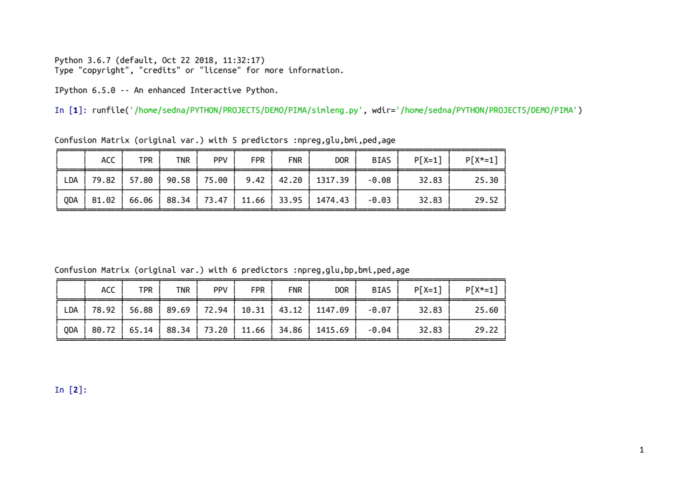
DISCRIMINATIVE METHODS

Slide 39

PRELIMINARY CONCLUSIONS
Glu and ped are most relevant predictors.
Genlogistic function with c lower than 0.5 has strong influence
on the detection of TRUE NEGATIVE, and by consequence,
it improves the prediction performance.
The best prediction with 3 predictors is 81.93%, which has
been obtained using GenLogistic function (with c=0.2) on
the features subset: npreg, bmi and ped.
The best prediction with 4 predictors is 80.12%.
This prediction on the features subset: npreg, glu, bmi and
ped has been obtained applying two different strategies:
-QDA to the original variables, and
-Logit to the transformed variables by PCA with four components
This result is consistent for the study and this features subset
represents 63.22% from training data information.

Slide 40

DISCUSSION
Analyze the influence of Genlogit shape (c) in misclassification
Investigate the poor prediction obtained solving the BIAS
equation.
To contrast the above predictions with MNLOGIT and MDA
predictions.
Analyze the influence of residue on the learning process
Analyze the application of resampling method to the fold
corresponding to the best cross-validation score.

Slide 41

COMPUTATIONAL TOOLS
Implementation of GenLogistic model in Statsmodels package
Implementation of K_fold Crossvalidation asociated to Statsmodels package
Developing of strategies code named :simleng.py on Python3.6.7.
MISCLASSIFICATION

